Slide 1
Southern Russia: Transportation Hub
Made by Artem Novoselov and Igor Pasko

Slide 2
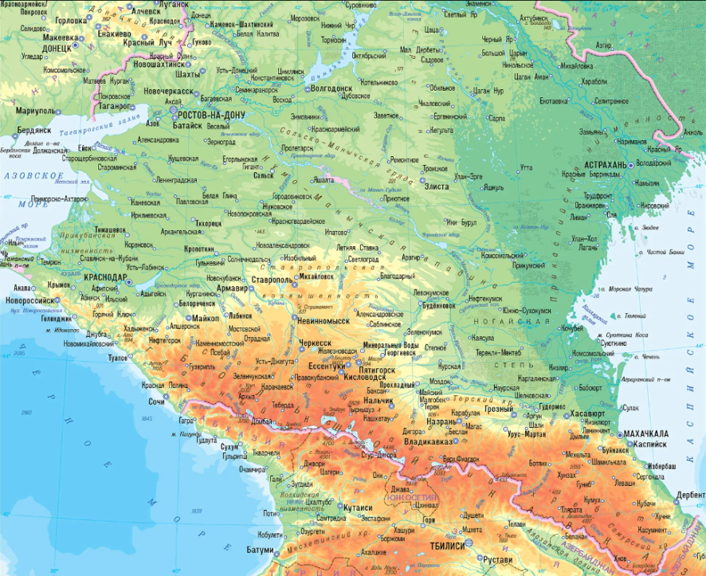
Energy production systems
The Southern Federal Region has substantial reserves of natural fuel and hydropower resources. Despite this, it remains energy deficient. The shortage of electricity is replenished by the flow from neighboring regions, which are part of the unified energy system of Russia. At the moment, the total capacity of the power plants of the UES of the South is 21,538.55 MW, 2,147 110-500 kV power transmission lines with a total length of 60,971 km and the number of power plants is 169 objects.

Slide 3
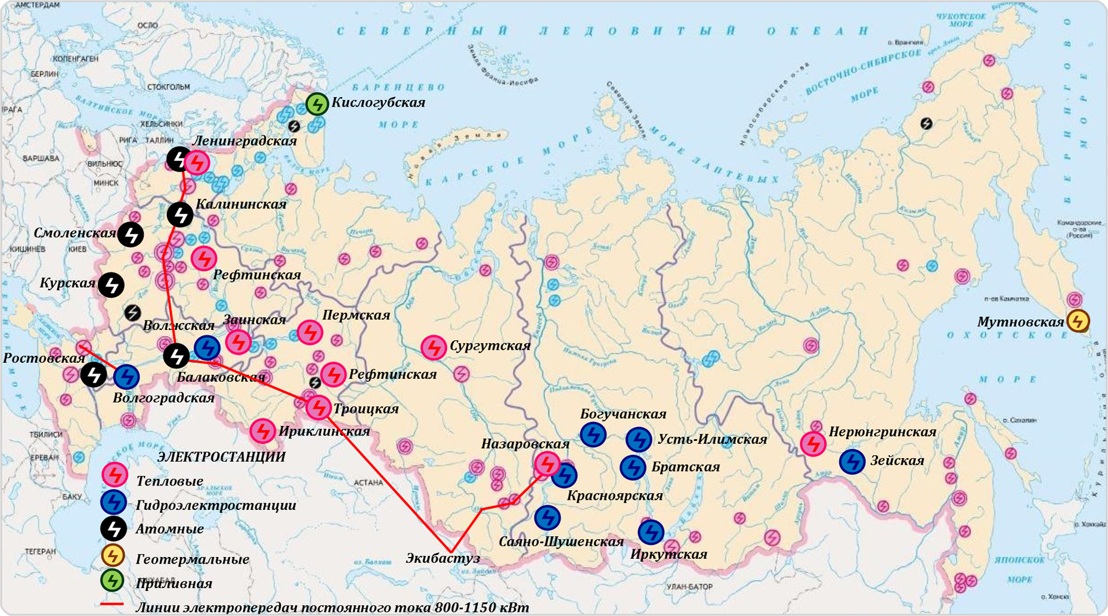
Energy production map

Slide 4
Several types of electricity generation are used in this region, such as:
1)Thermal power plants (56.55%)
2)Hydroelectric power plants (27.59%)
3)Nuclear power plants (13.93%)
4)Solar power plants (1.5%)
5)Wind power plants (0.43%)

Slide 5
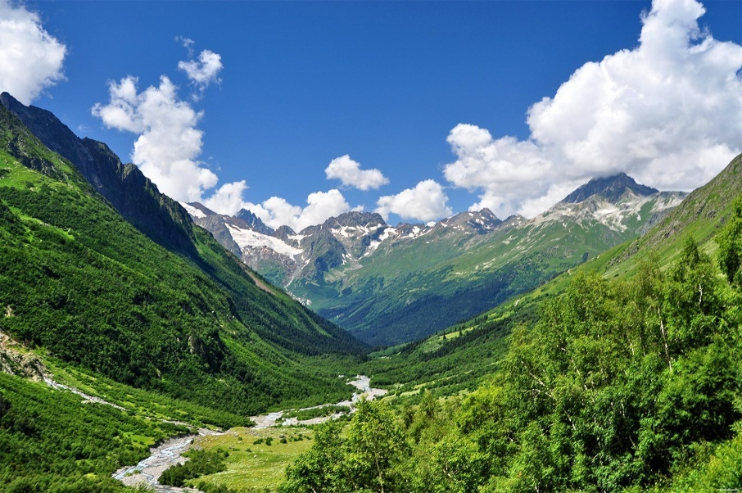
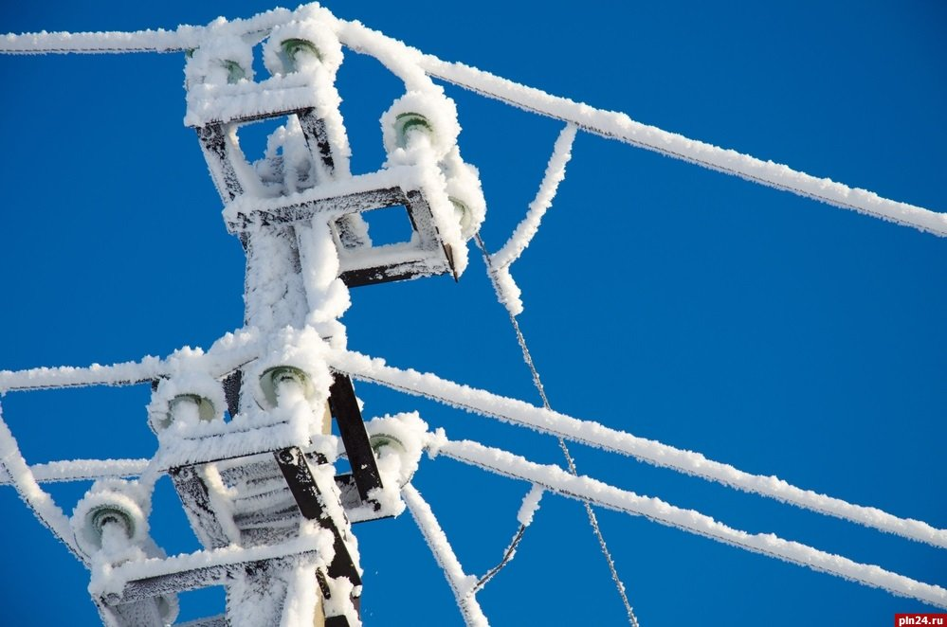
Сlimate and geographic location
The Southern Federal Region is located on an area of 447.8 thousand square kms. It unites eight constituent entities of the Russian Federation. This region has several climatic and geographic features that affect the operation of the power grid.

Slide 6
The electric grid complex of the region stretches mainly from the north-west to the south-east along the Caucasian Ridge along the territory of areas where cases of ice formation on wires are often recorded.
The rivers of the North Caucasus are characterized by an extremely uneven distribution of runoff. This has a significant impact on the electricity balance: a surplus is created in summer, and a deficit in winter.
Due to seismic activity in the region, there is a great risk in the construction of new nuclear power plants.
The Southern Federal Region is one of the most promising regions of Russia for the development of solar energy. Here the number of sunny days varies from 150 to 300 days during the year.
The average wind speed here is about 4 m/s, and in the Krasnodar region it can reach 44 m/s, which contributes to the development of wind energy.

Slide 7


Development trends
Currently, the main development trend is the introduction of new equipment and technologies in the production of electricity. A very important role in the development of the region will be played by solar power plants under construction, which have high efficiency in a sunny area. It is also planned to build new nuclear power plants and wind turbines.

Slide 8
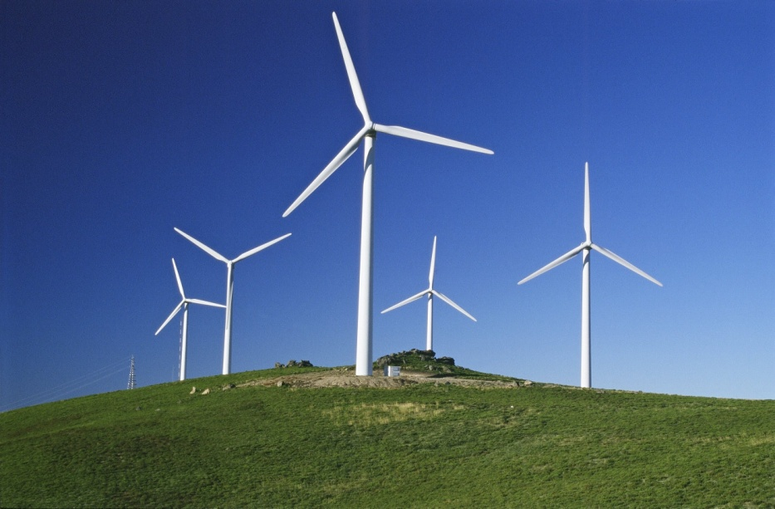
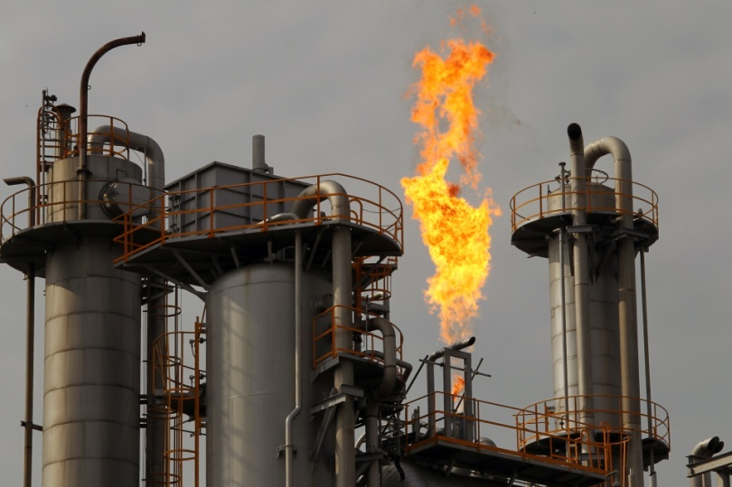
Renewable and non-renewable energy sources
Currently, non-renewable energy sources such as coal and natural gas are mainly used in the region. Power plants using the flow of water to create electricity are also actively used. In the future, it is planned to use renewable sources such as solar and wind, but unfortunately now the technologies necessary for this are too expensive.

Slide 9
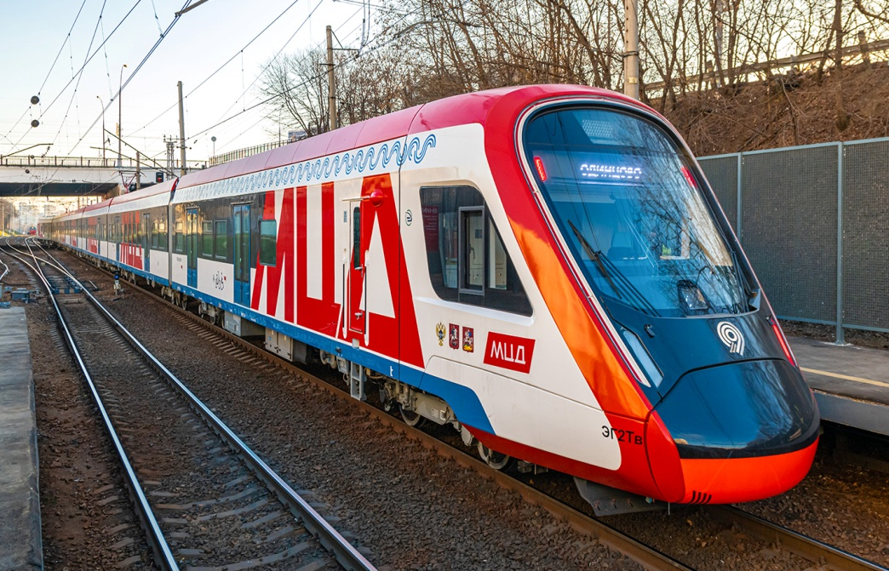
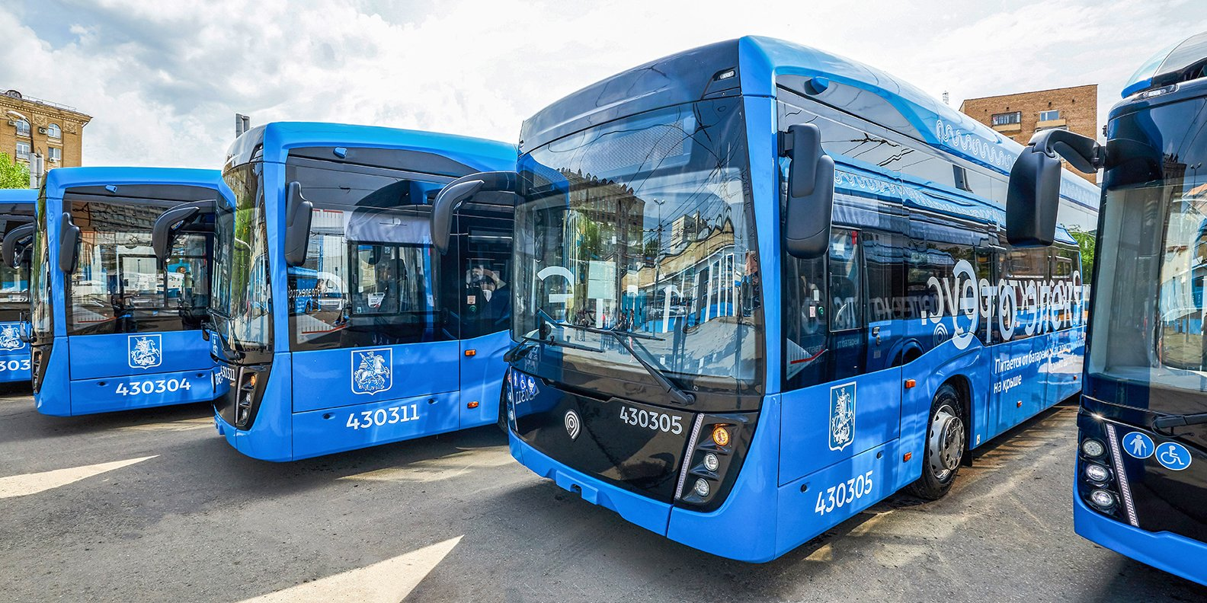
Estimation of required amount of energy

Slide 10
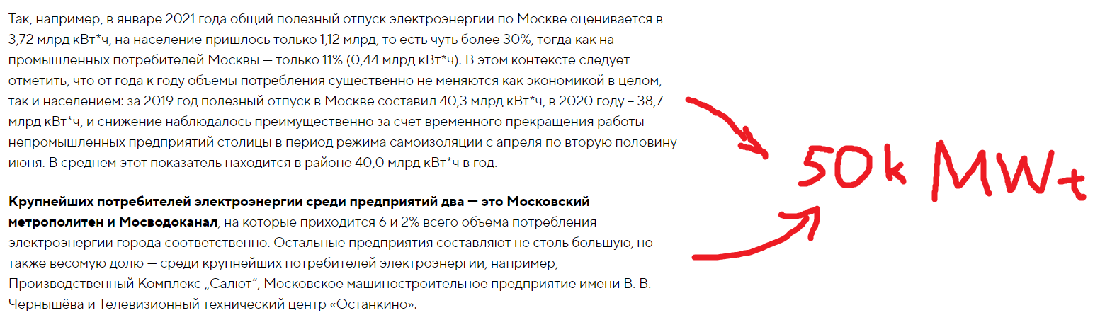
Moscow transport system energy consuming

Slide 11
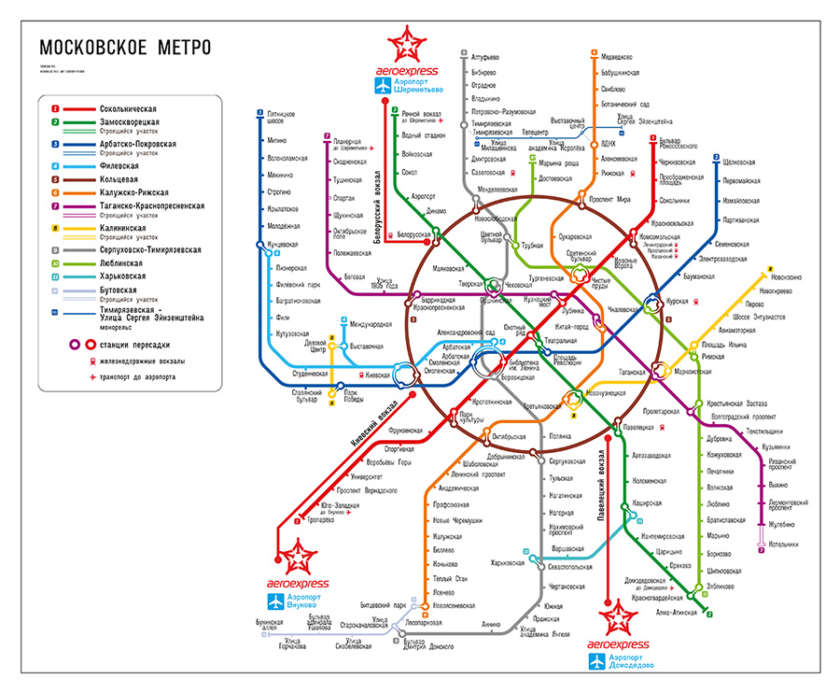
But Moscow transport system is really giant…
250 Moscow metro stations
About 300 electrobuses
10 ground mainstay railways with 10 large terminals
4 large bus stations
And some other kinds of electricity-consuming transport …

Slide 12
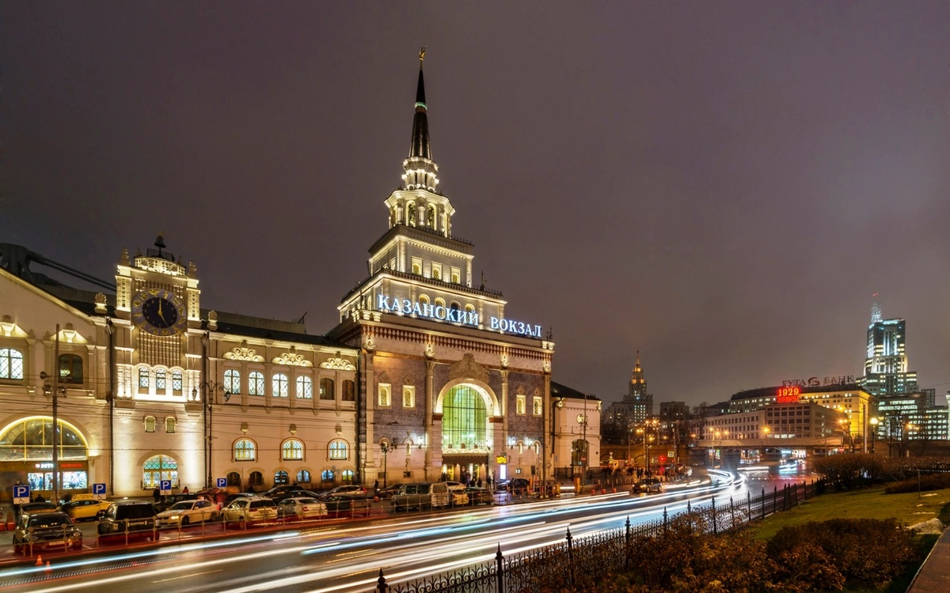
And we are building only one transport hub…
…So we can primary estimate its power consumption , with a big stretch, as 1/100 of all the Moscow consumption… which should be only 0.5 MWt. But 0.5 MWt is less then 3% of overall SFR power production, so it’s likely that integration of this object in Southern region energetic system is acceptable.

Slide 13

THANK YOU
FOR YOUR
ATTENTION!

